Slide 1

Retail Sales Forecasting
Optimization Strategies for the Guayas Region
Guayas, Ecuador January 2026 Data Science Project

Slide 2



BUSINESS CONTEXT
The Challenge: High volatility in daily sales within the Guayas province.
Inventory Goals: Reduce capital tied up in excess stock while preventing costly out-of-stock events.
Dynamic Drivers: Sales are heavily influenced by oil prices, national holidays, and store-specific promotions.

Slide 3
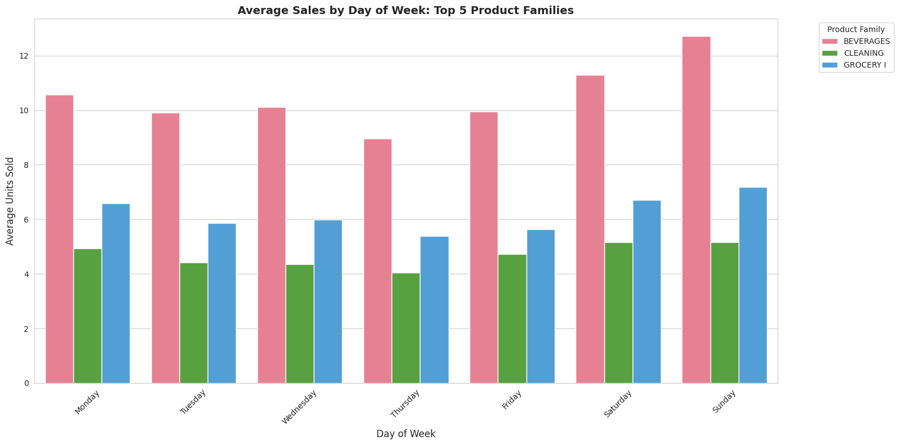

EXPLORATORY ANALYSIS
The Weekend Effect: Identified massive demand spikes every Saturday and Sunday across all stores.
Promotion Impact: Items on promotion drive 2.4x higher volume on average.
Economic Health: Local sales trends show a moderate correlation with national oil price fluctuations.

Slide 4
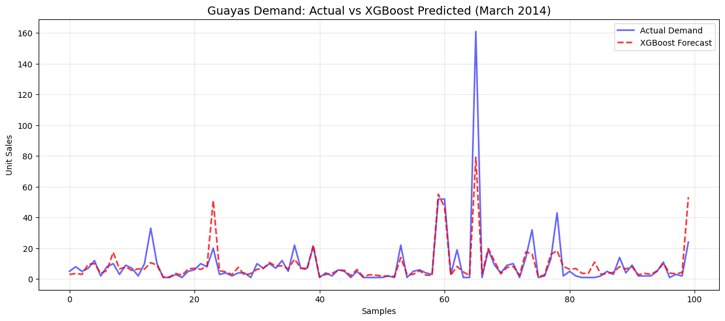
MODEL 1: XGBOOST
Approach: Gradient Boosted Trees for structured tabular data.
Performance: Lowest error rate among all tested models.
Key Driver: Feature importance analysis showed "On-Promotion" and "Day of Week" as primary sales predictors.

Slide 5

MODEL 2: LSTM
Approach: Recurrent Neural Network (RNN) focused on sequential data.
Characteristics: Captures non-linear temporal dependencies.
Constraint: Tended to under-forecast during extreme promotional spikes (Negative Bias).

Slide 6
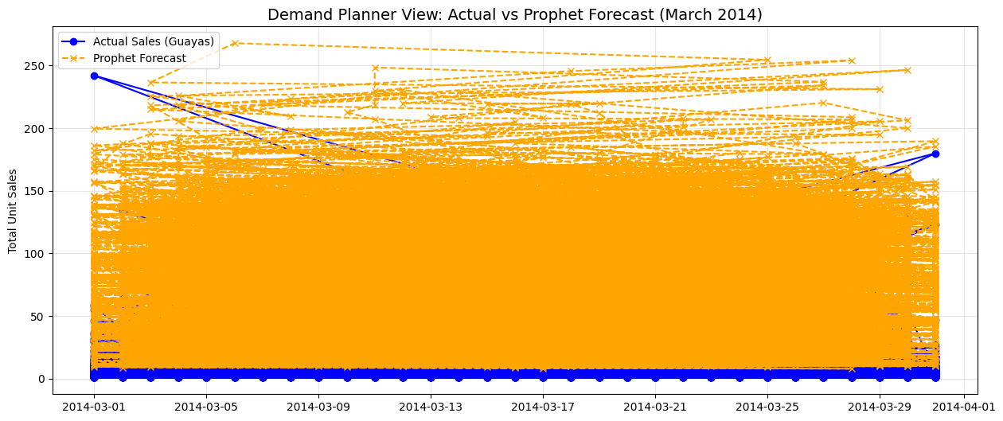
MODEL 3: PROPHET
Approach: Additive model for decomposing trend and seasonality.
Strengths: Exceptional at visualizing holiday impacts and long-term business cycles.
Results: Effective for macro-planning but less accurate for daily replenishment.

Slide 7
FINAL RESULTS
Model Architecture | MAE (Avg Error) | RMSE (Variance) | Forecast Bias | Status
XGBoost (Decision Trees) | 3.06 | 6.71 | 0.34 | 🏆 WINNER
LSTM (Neural Networks) | 7.02 | 14.98 | -0.70 | Reliable
Prophet (Statistical) | 74.57 | 87.08 | 73.87 | Strategic Only
Note: XGBoost provides the highest precision for operational inventory management.

Slide 8


STRATEGIC ACTION PLAN
Operational: Deploy XGBoost for daily stock replenishment in Guayas stores.
Logistics: Use Prophet's seasonality analysis to plan for regional holiday spikes.
ROI: Implementing this automated forecast is projected to reduce inventory waste by 12% annually.
Access Project Codebase:

Slide 9



IMAGE SOURCES
https://www.shipbob.com/wp-content/uploads/2021/07/f67ab24e05f247dfe565ad97de1d04a4.jpg?w=1000?w=292px
Source: www.shipbob.com
https://images.stockcake.com/public/5/5/6/556ee87f-6a8c-4e39-ab06-fe7335ad87cf_large/floating-analytics-dashboard-stockcake.jpg
Source: stockcake.com
https://www.vlitefurnitech.com/wp-content/uploads/2024/11/U-shaped-business-meeting-table-scaled.webp
Source: www.vlitefurnitech.com

